Slide 1
Hydrological Information System
Module - Automatic Weather Station and Automatic Rain Gauge
Anish
….. Hydro-Informatics Expert
The World Bank

Slide 2
Examples that refer to products are intended for illustrative purposes only, and do not imply an endorsement or recommendation of any particular product

Slide 3
Introduction
What is Automatic Weather Station?
What Data does it provide?
How and where that data is useful?
Calculation of Evaporation
Loss from Lakes and Reservoirs
Estimation of Evapotranspiration
Crop water requirement estimation
Weather forecasting
Temperature, pressure humidity variations

Slide 4
Module Contents
Network Design
Site Selection
Selection of Instruments
Data logger
Integration of Other Sensors in AWS
Telemetry
Installation
Sensor Specification
Costs
Operation and Maintenance

Slide 5
WMO Guidelines for Minimum Network Density
Region | Minimum density in km²/gauge
 | Non-recording (SRG) | Recording (ARG)
Hilly region | 250 | 2,500
Semi-hilly region | 500 | 5,000
Plains, high rainfall region | 500 | 5,000
Plains, low rainfall region | 900 | 9,000
Arid region | 10,000 | 100,000
Network Density

Slide 6
Physical Location
Security
Telemetry Window
Power Options
Accessibility
Ownership of Land
Site Selection

Slide 7
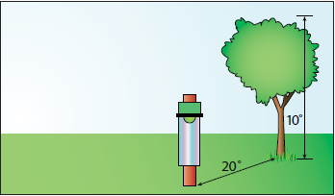
Site Selection for Rain Gauge
Site Selection

Slide 8
Site Security
Preferably at Manned positions
Research Stations of Agricultural Universities
Dam and Barrage Sites
Govt. Rest Houses, Circuit Houses
District / Block Headquarters
Private Property
Police Stations ?
Site Selection

Slide 9
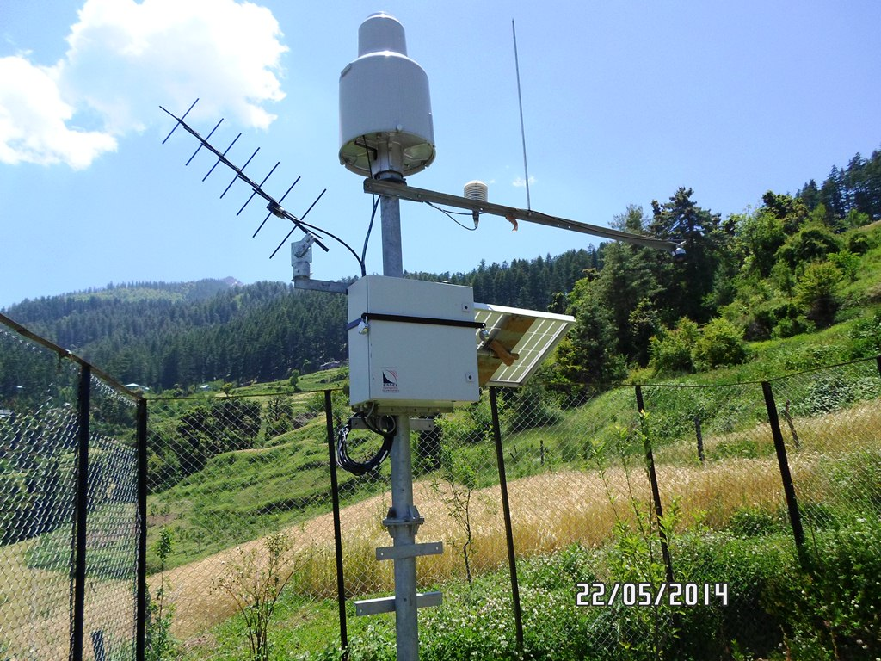
Examples of Good Sites for AWS
Site Selection
AWS in a Private Property at Madana

Slide 10
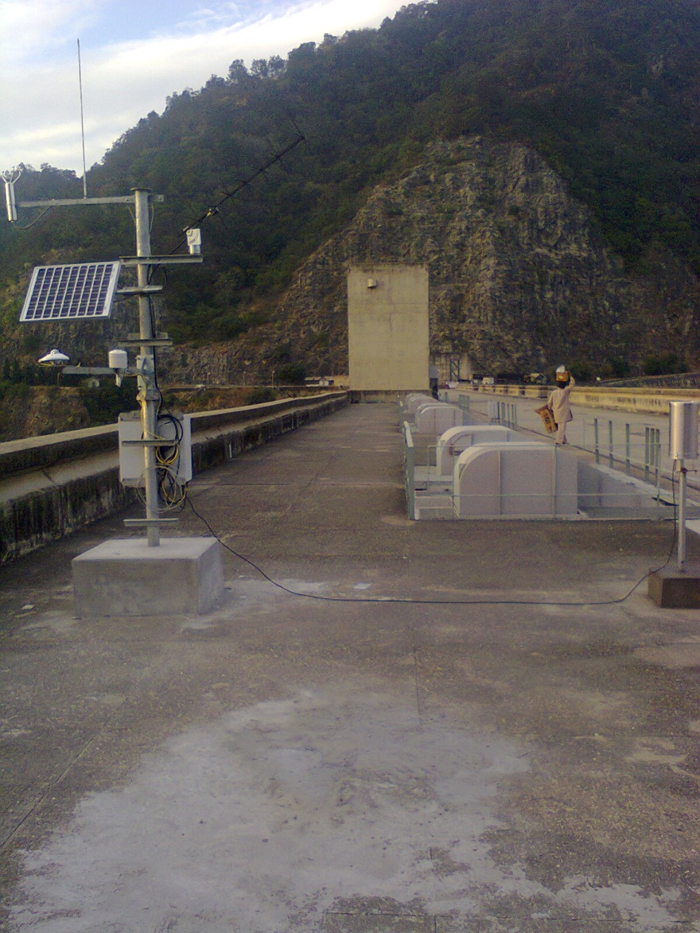
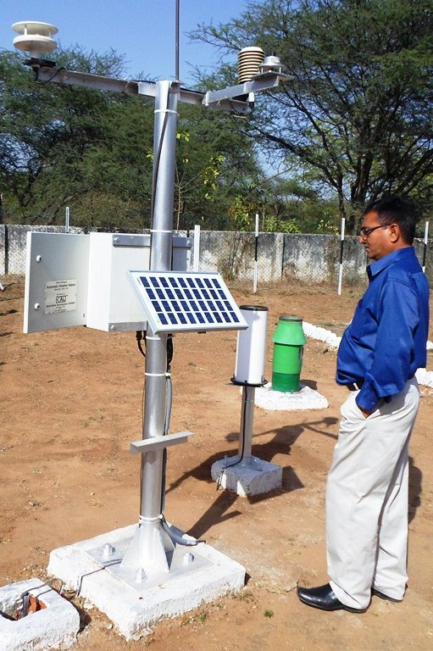
Examples of Good Sites for AWS
Site Selection
AWS on top of Bhakra Dam
AWS in WRD Premises, Gandhinagar

Slide 11
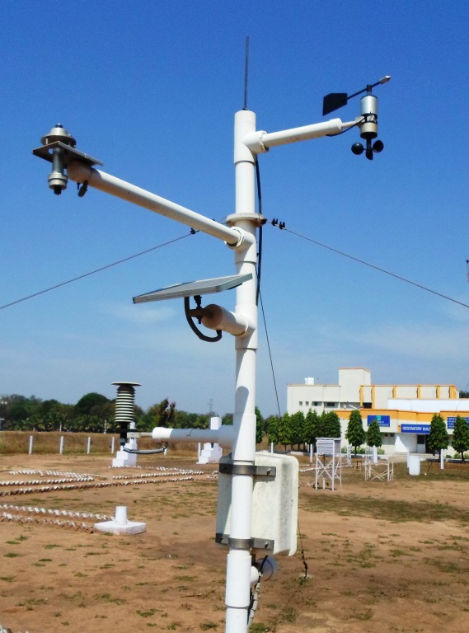
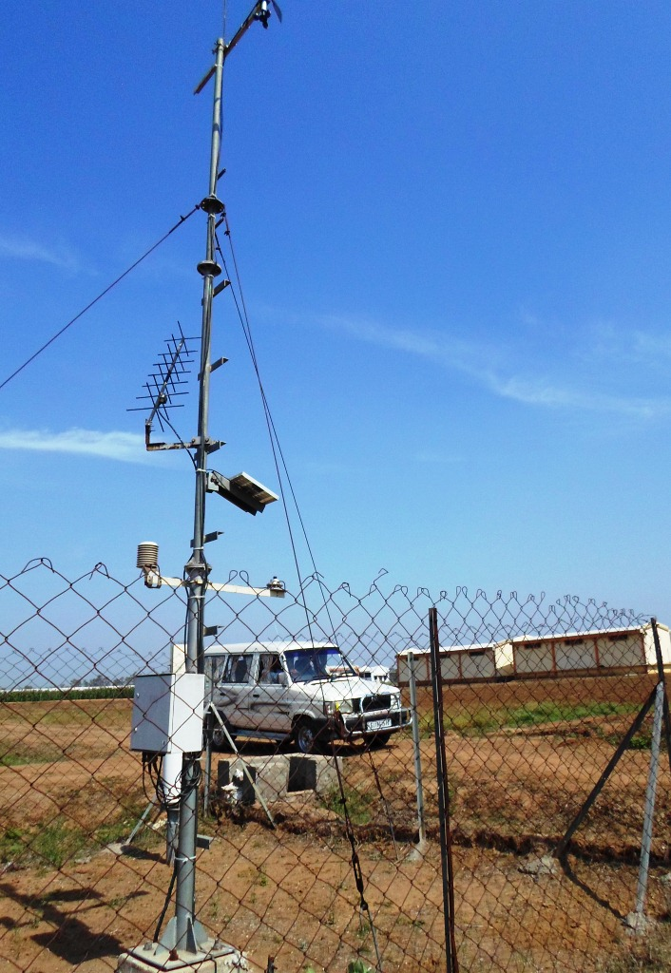
Examples of Good Sites for AWS
Site Selection
AWS in Anand Agricultural University Campus, Anand
ISRO AWS inside Agricultural research Station in Sampli, Gujarat

Slide 12
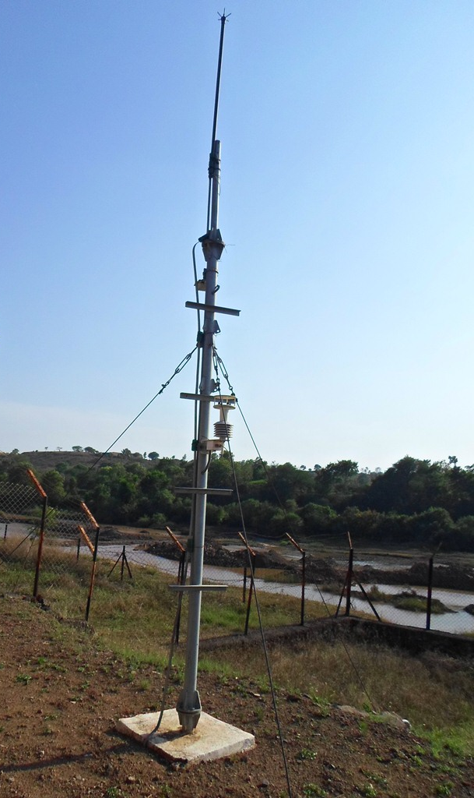
Examples of Good Sites for AWS
Site Selection
AWS at WRD premises near Pune, Maharashtra

Slide 13
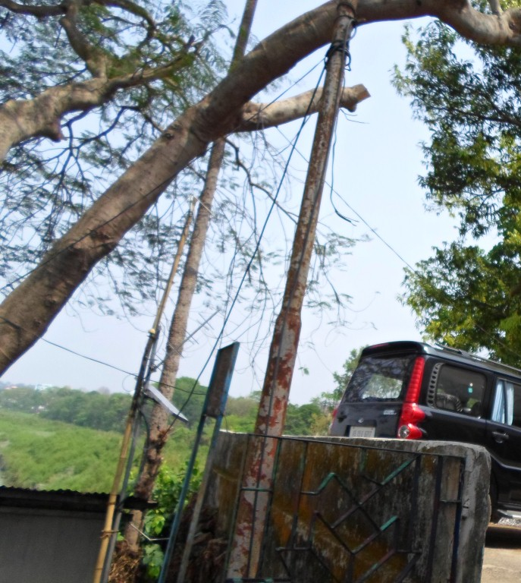
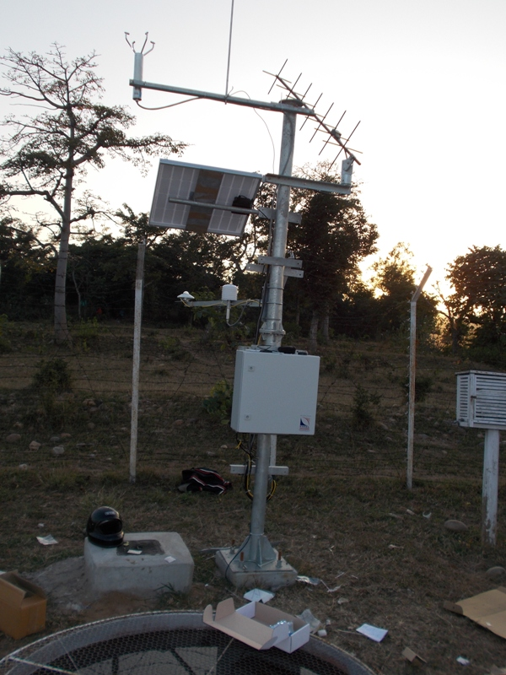
Telemetry Window
For Satellite Telemetry, Direct Line of Site
Good Mobile Coverage for GSM based
Site Selection
Antennae LoS Obstructed by trees
No Problem Here!

Slide 14
Power Options
Is Reliable AC Power available?
2-3 Hours a day enough to Recharge battery
For Solar, is enough Sunlight Available?
What should be size of Solar Panels
What should be size of Battery?
100 AH Battery with 40 Watt Solar Panel recommended for North India
64 AH with 24-30 Watt Panels for Tropical Regions (Below 23 degree latitude)
In Gujarat, 26 AH Battery with 10 W Panels also used
Internal Battery not an option for AWS
Site Selection

Slide 15
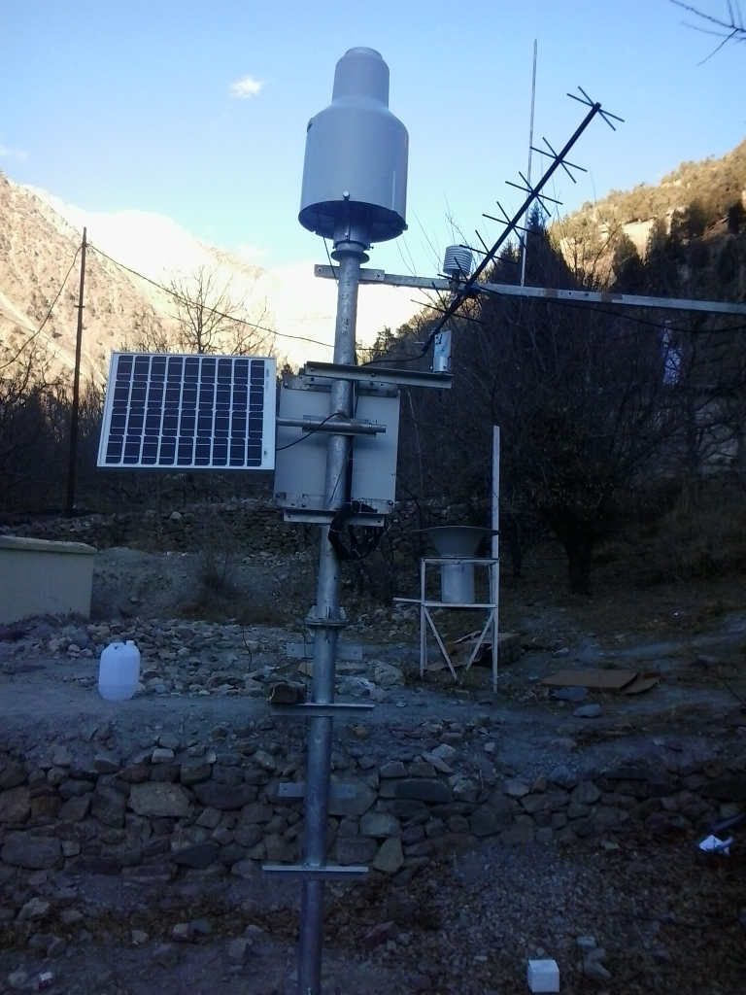
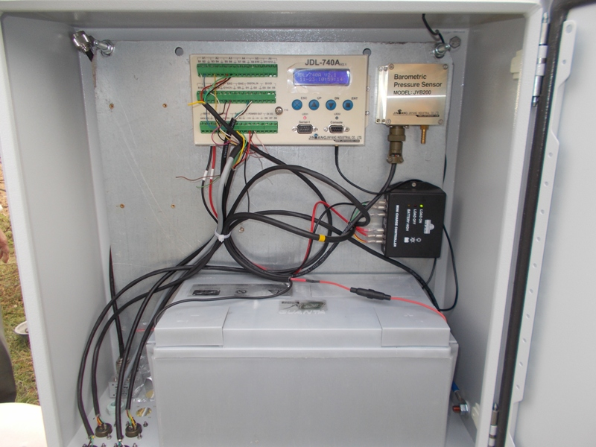
Power Options – Himachal Region
Site Selection
100 AH Battery
40 Watt Solar Panel

Slide 16
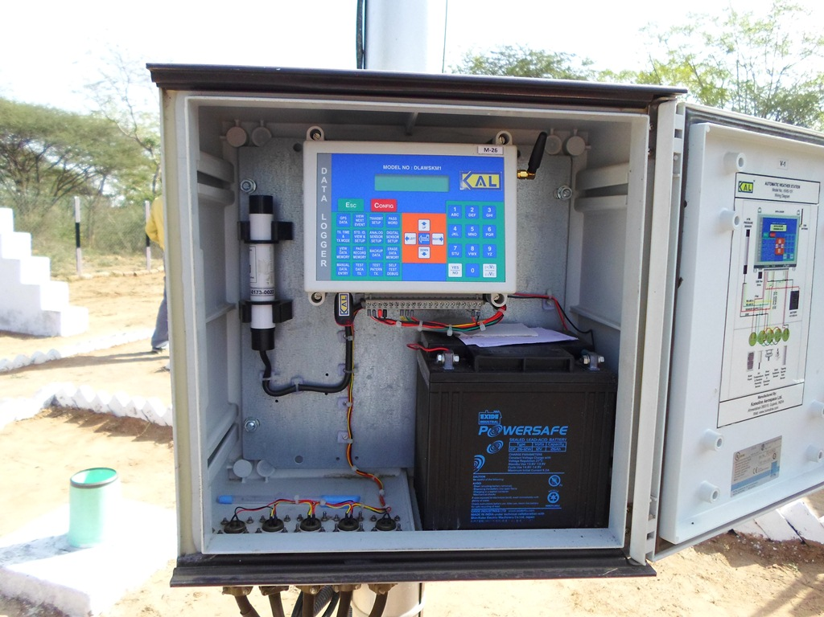
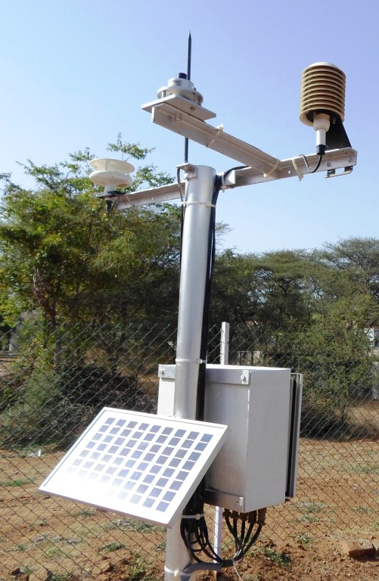
Power Options – Gujarat
Site Selection
26 AH Battery
With 10 Watt Solar Panels

Slide 17
Selection of Sensor
Automatic Rain Gauge
Solar Radiation
Wind Velocity and Direction
Temperature
Humidity
Atmospheric Pressure
Evaporation
Selection of Instruments

Slide 18
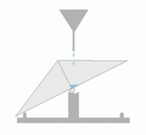
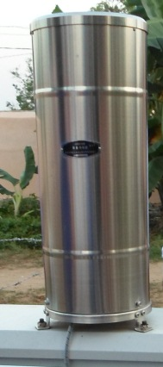
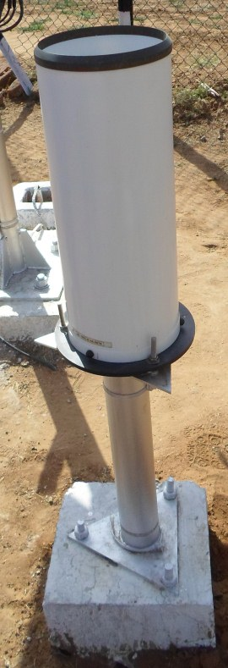
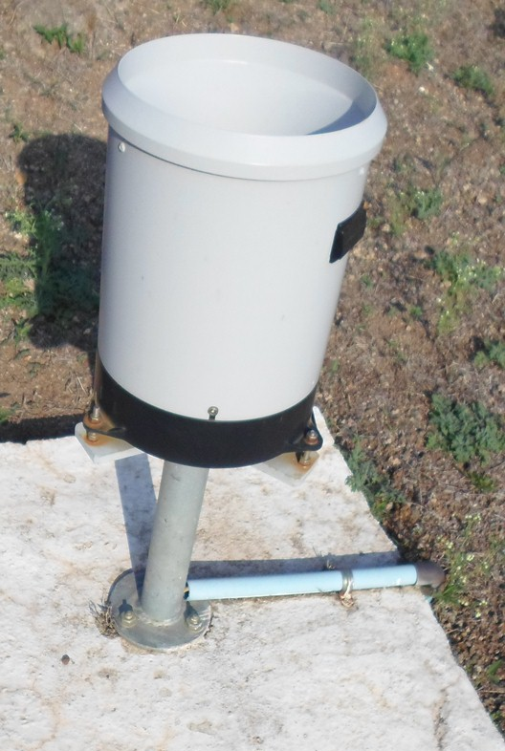
Automatic Rain gauge
Tipping Bucket Rain gauge
Dual Reed Switch to count Bucket tips
Available with or without Syphon
Selection of Instruments
Odisha
Gujarat
Maharashtra

Slide 19
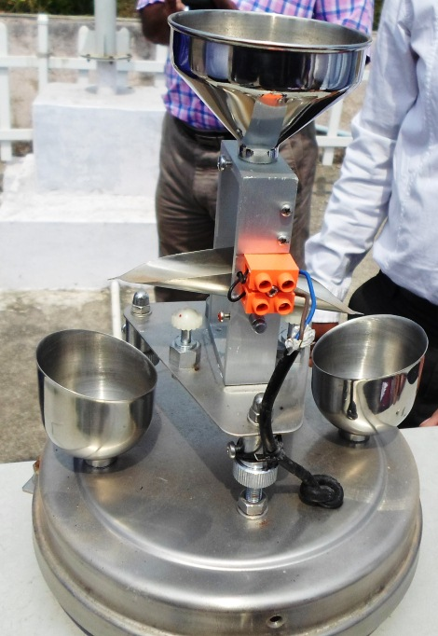
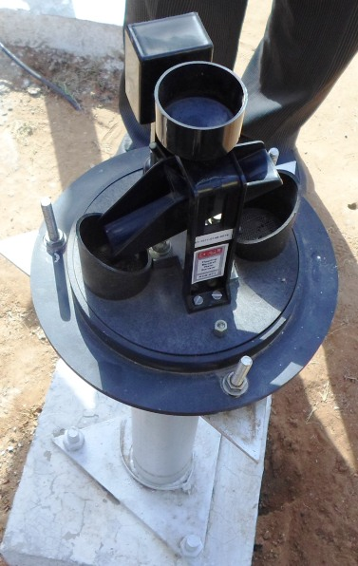
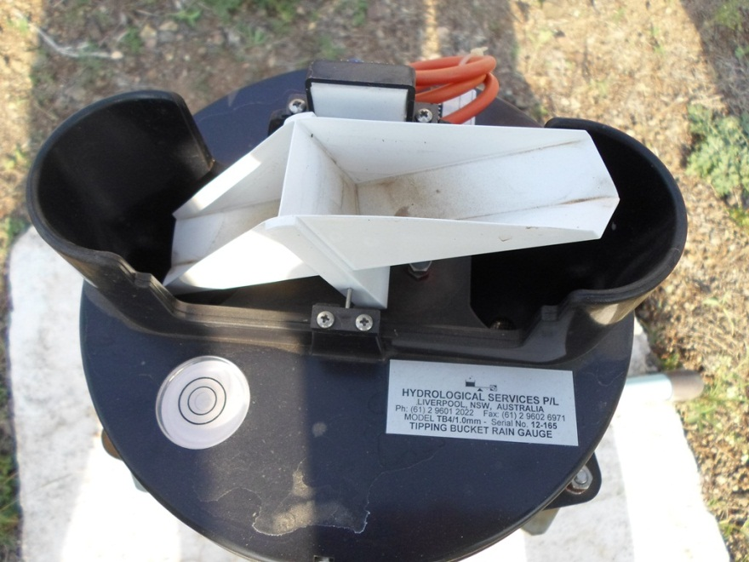
Automatic Rain gauge
Sensor Type Tipping Bucket with reed switch
Range 0-500 mm/h
Bucket Capacity 0.2, 0.5 or 1.0 mm
The size depends on Peak Rainfall Intensity
Specifications
0.2 mm
0.5 mm
1.0 mm

Slide 20
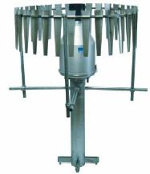
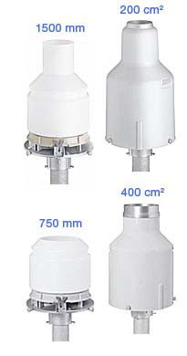
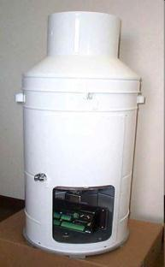
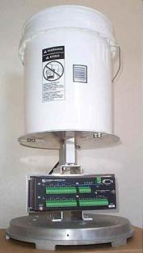
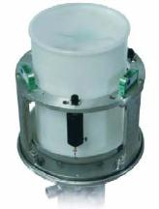
Rain and Snow Gauge
Sensor Type Weight Sensor
Range upto 1500 mm

Slide 21
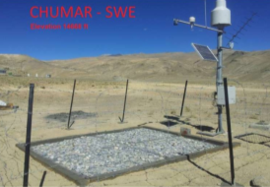
Snow Depth Sensor
Temperature Sensor
Rain and Snow Gauge
Snow Pillow

Slide 22
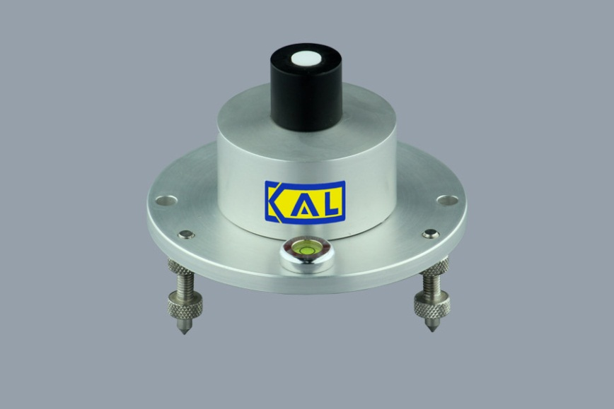
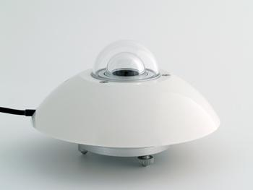
Solar Radiation
Silicon Photodiode based sensors
Calibration depends on Solar Azimuth angle
Cheaper option
Thermopile based Sensors
Class 1 Equipment
Expensive but more reliable option
Selection of Instruments
Silicon Photodiode Sensor
Thermopile based Pyrometer

Slide 23
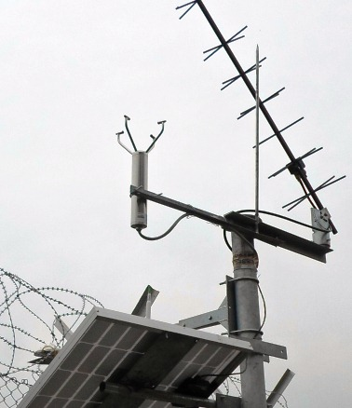
Wind Velocity and Direction
Ultrasonic Sensor with no moving parts
Maintenance free but expensive option
One sensor provides direction and velocity
Selection of Instruments
Site in Gandhinagar, Gujarat
Site in Brahmani, Himachal Pradesh

Slide 24
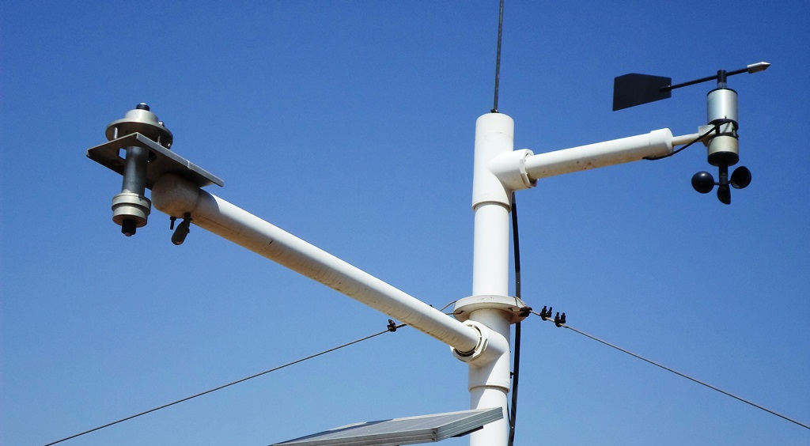
Wind Velocity and Direction
Wind vane and Cup Anemometer
Cheaper option
Moving Parts, Needs frequent maintenance
Selection of Instruments
Site in Anand, Gujarat

Slide 25
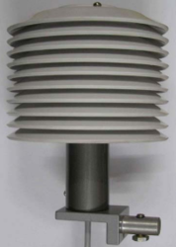
Temperature and Humidity Sensor
Resistance based Temperature Sensor
Capacitive Humidity Sensor
Often Temperature and Humidity sensors come as single hardware
Selection of Instruments

Slide 26
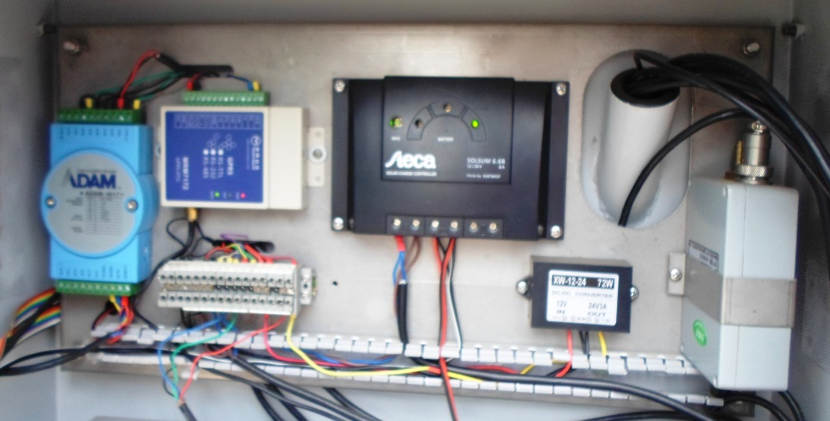
Atmospheric Pressure
Sensor based on MEMS
Indoor unit
Selection of Instruments
Site in Bhubaneswar, Odisha
Site in Sampli, Gujarat
Site in Harsar, Himachal Pradesh

Slide 27
General Features
Central and Most Important part of AWS
Functions
Supplies Power to Sensors,
Reads and record data
Pass on data to telemetry unit for transmission
Highly configurable based on requirements
Some Models available with inbuilt GSM transmitter
Some Data loggers are integral part of Sensor
Data Logger

Slide 28
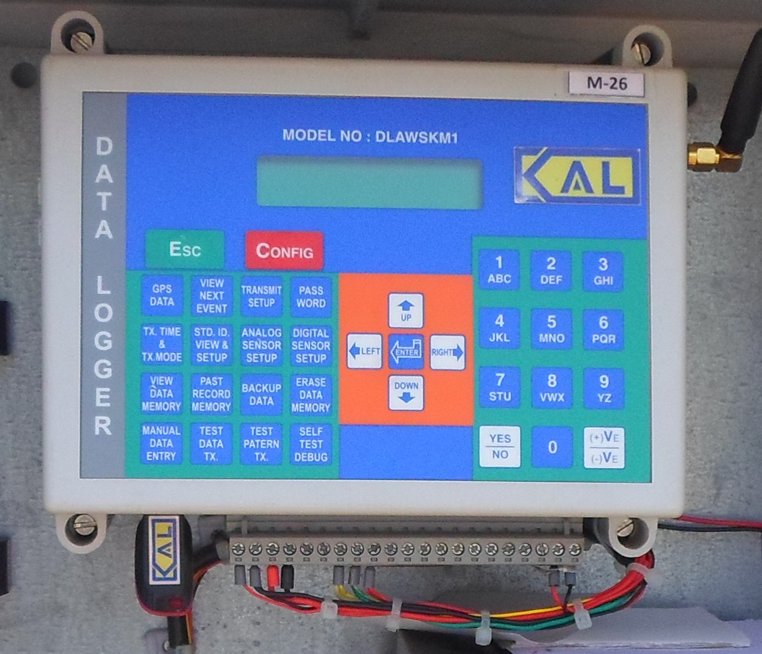
Data logger - Examples
Data Logger
Komoline Data logger with inbuilt GSM Transmitter, Ahmedabad

Slide 29
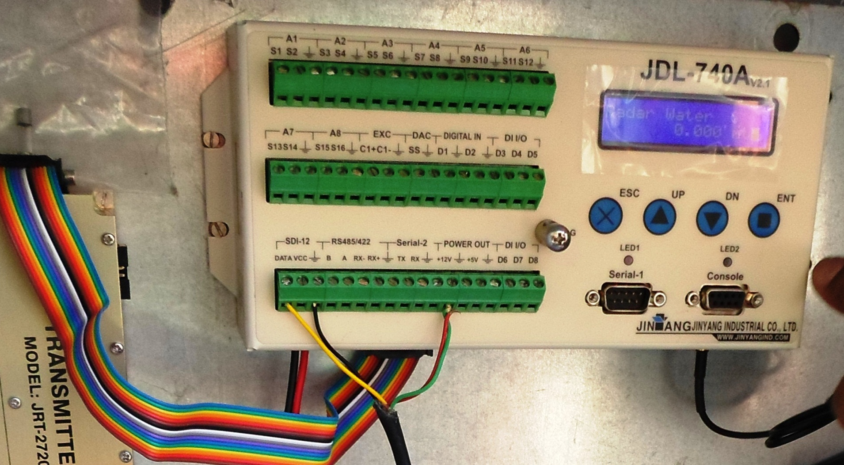
Data logger - Examples
Data Logger
Jinyang Data logger showing input, output and communication ports, Kapla, Himachal Pradesh

Slide 30
Data logger - Examples
Sutron Data Logger with in built Satellite Transmitter
Sutron Data Logger with inbuilt Satellite Transmitter, Display and Keypad
Data Logger

Slide 31
Integration of AWS with other Sensors
Data Logger is the major deciding factor for feasibility of integration
With Specifications of Data Logger mentioned above, it is possible to integrate any type of station and large number of sensors
Future Integration needs should be considered for deciding Data logger Specifications
If no need for integration – Low end Data logger
If chance of adding more sensors in future – High end Data logger (Expansive option)
Integration

Slide 32
Integration Examples
AWS Installed at Nangal Dam (Punjab) along with
Reservoir Water Level
Outflow Canal Water Level
Connectivity via wires for Dam level and Canal A
Wireless connectivity with Canal B
Integration

Slide 33
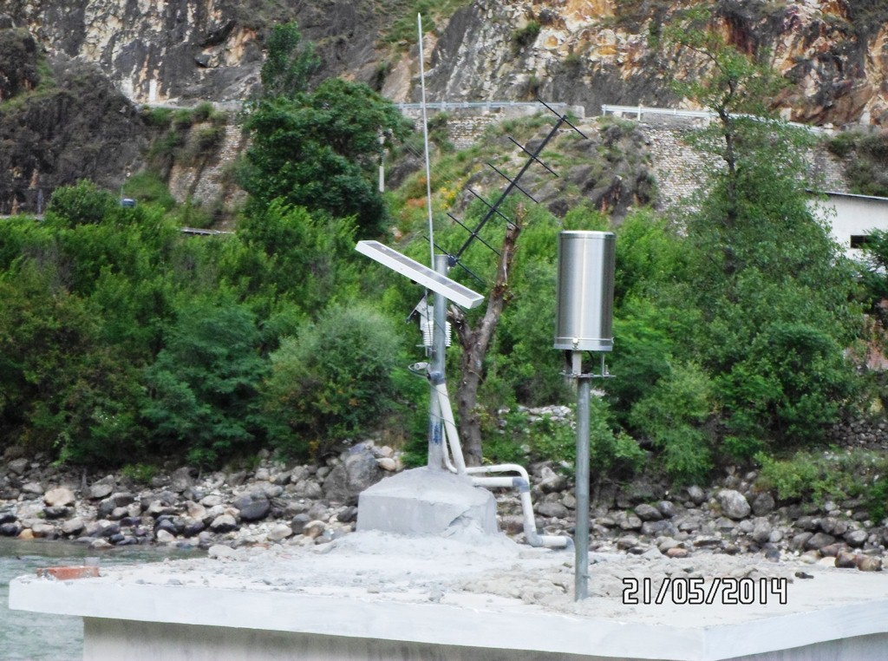
Integration Examples
Integration
Integration at Bhuntar on Beas River with
River Gauge site using bubbler
River Discharge site using ADCP

Slide 34
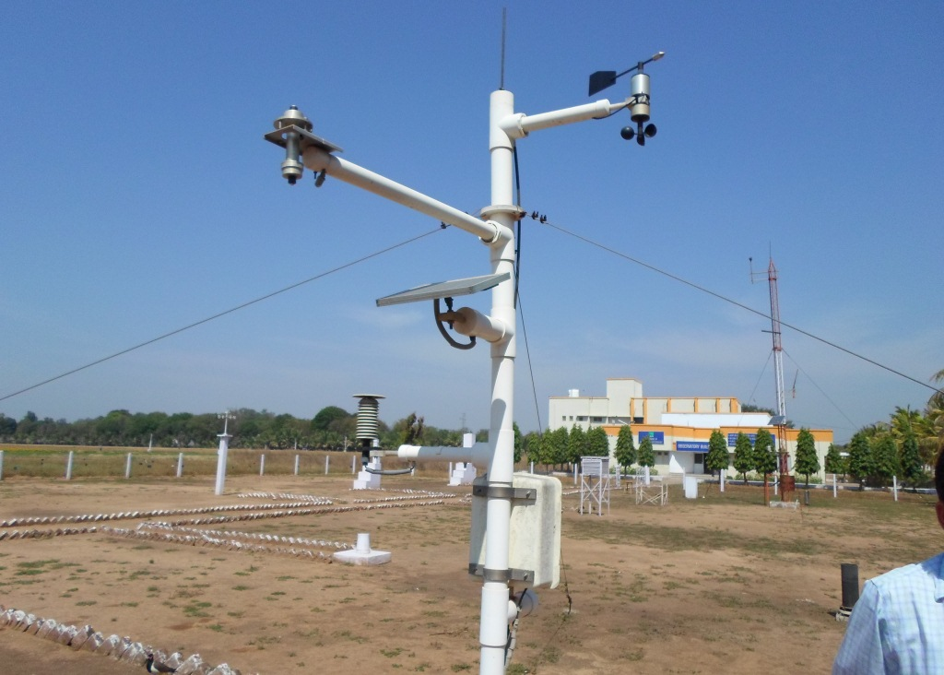
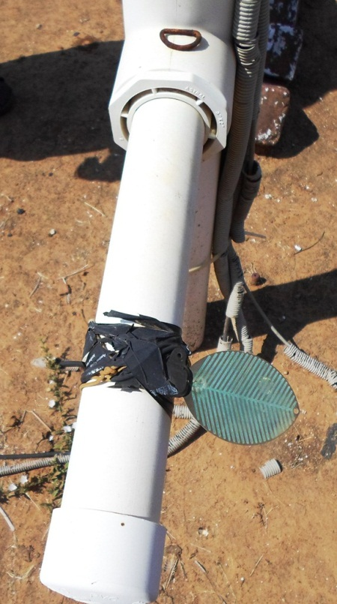
Integration Examples
Integration
Integration at Anand, Gujarat with
Soil Moisture Probe
Leaf Wetness Sensor
Groundwater Level Sensor

Slide 35
Introduction
The telemetry Device transmits data to central server location
Can provide One-Way or Two Way Communication
One Way – Push method
Two Way – Push and Pull Method
The communication medium can be:
GSM Towers
Satellites
INSAT Radio Transmitter
VSAT
Telemetry

Slide 36
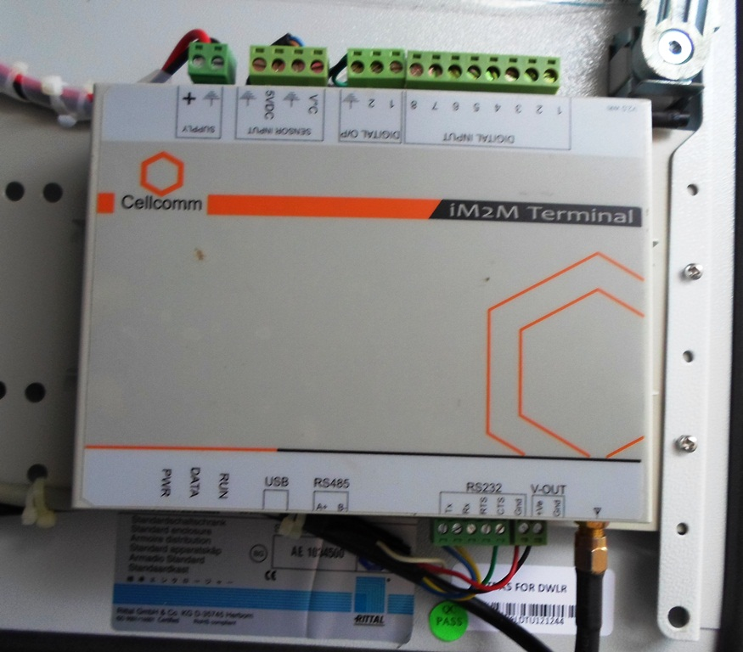
GSM Based Telemetry
The Telemetry device has SIM card
Can transmit via SMS or GPRS internet
Telemetry Device can be:
Telemetry
Integral part of Data logger
Separate Device

Slide 37
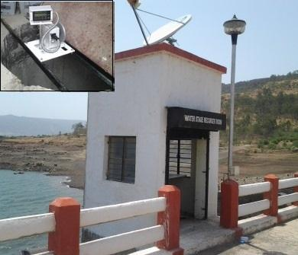
Satellite Based Telemetry
Telemetry
VSAT based two way communication
INSAT based one way communication
Finer Details of Telemetry are covered in Telemetry Module

Slide 38
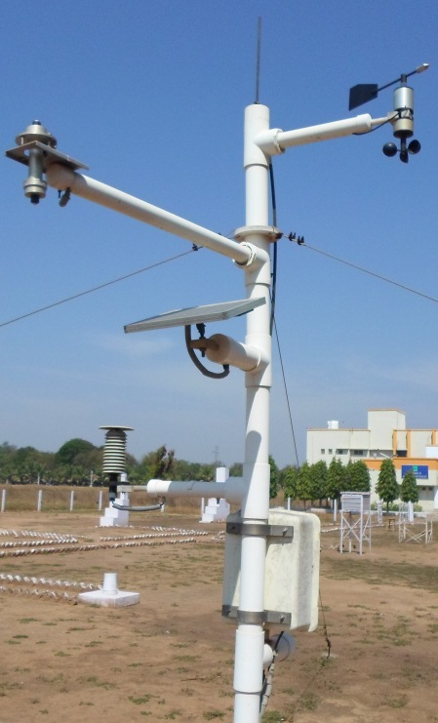
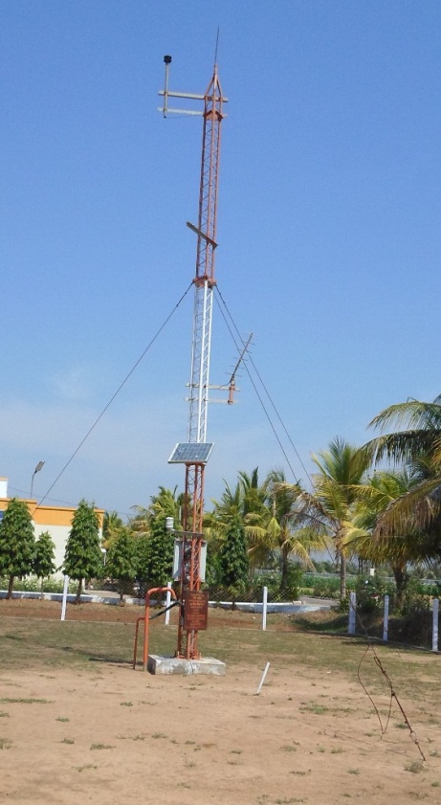
Masts
Masts should be Sturdy, rust proof
Installed on good concrete foundation
Should not vibrate with wind
Installation

Slide 39
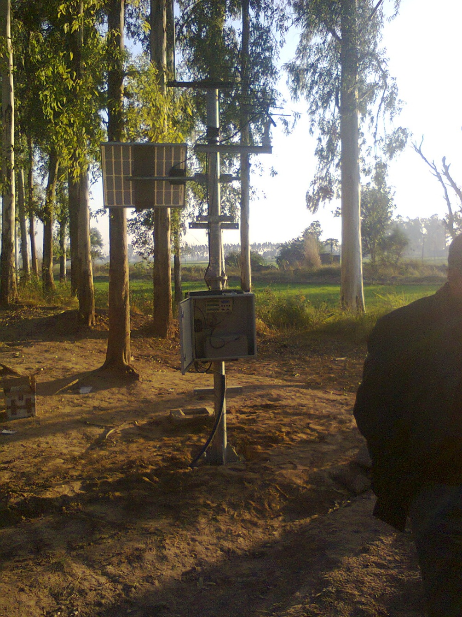
Solar Panels
Installation
What is wrong here?
Solar Panel in Shadow of Trees

Slide 40
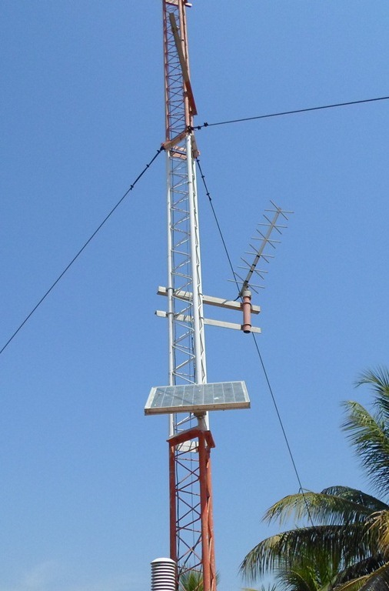
Solar Panels
Installation
Chitkul, Himachal Pradesh
Anand, Gujarat

Slide 41
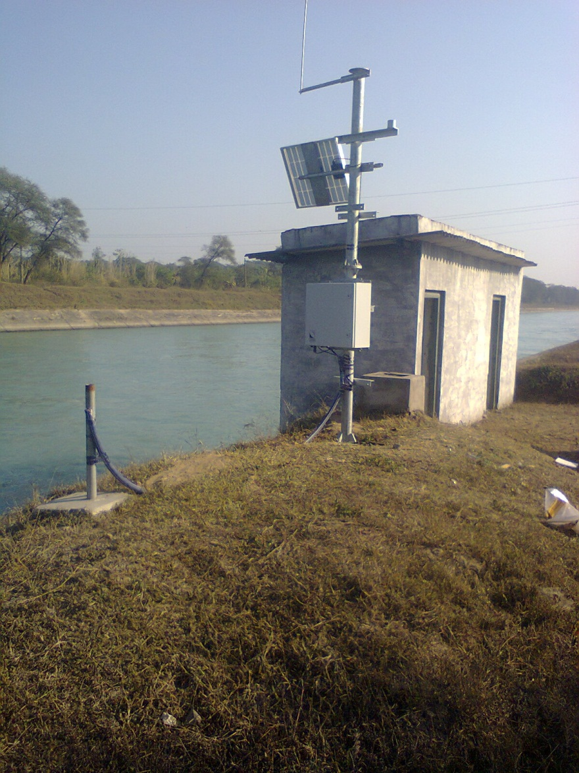
Solar Panel
Almost Vertical in Himachal
Almost Horizontal in Gujarat
Installation
What should be Right Direction?
What is major difference in solar Panel Installation?

Slide 42
Solar Panel - Direction
In Northern Hemisphere, Solar Panel always faces South
This maximizes sunlight, specially during winter
The tilt angle w.r.t. ground should be equal to Latitude of Location
Horizontal (0 degree tilt) at Equator
30-35 degree for northern states
Installation

Slide 43
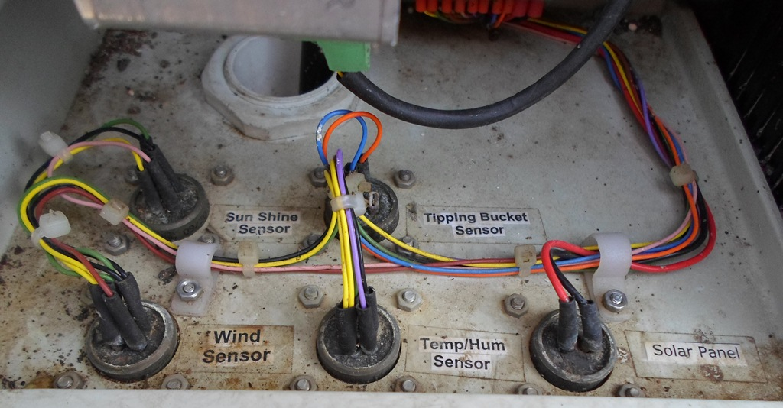
Connections and Wires
Installation
Label the Connection wires if feasible

Slide 44
Automatic Rain gauge
Accuracy (Intensity) 2 % or better
Output Interface As specified in Data logger
Rain collector Material
Corrosion Resistance Metal (Stainless steel/ Aluminum) or UV Stabilized Fiber Plastic
Enclosure IP65
All openings of the rain gauge shall be covered with a screen to protect against insects
Syphon system to eliminate over accumulation or under accumulation of precipitation
collecting funnel diameter 200mm
Ability to service tipping buckets without involving the re-levelling of the gauge
Specifications

Slide 45
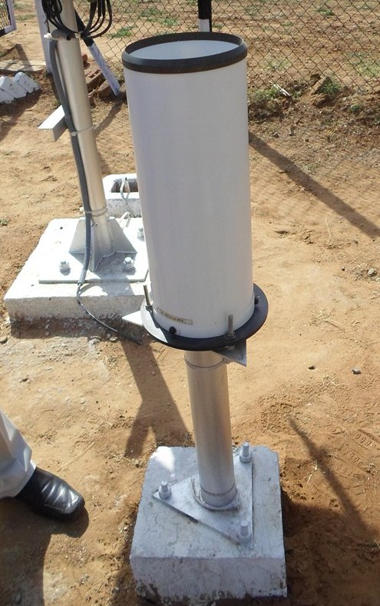
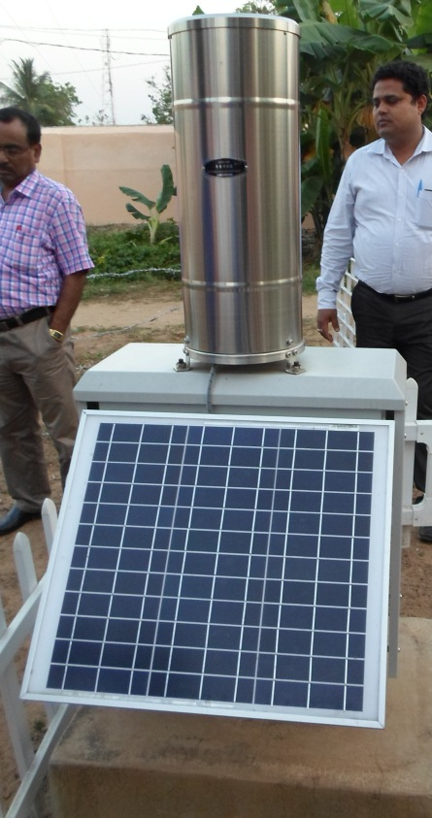
Automatic Rain gauge
Specifications
Leveling Mechanism
Raingauge with UV Stabilized Fibre Plastic Body
Raingauge with Stainless Steel Body

Slide 46
Feature | Units
Site Conditions
Ambient Temperature | From -20 to +60
Humidity | 5 to 100 %
Altitude | 0 to 5000 meter
Sensor
Sensor Type | Ultrasonic sensor
Range | 0-10 meter
Resolution | 1 mm or better
Accuracy | 0.25 % of measuring distance
General Features
Output Interface | SDI12/ RS 485 / Compatible with Data logger
Power Supply | 9-18 V DC
Material | Corrosion Resistance Metal (Stainless steel/ Aluminum or PVC)
Enclosure | NEMA 4
Tools | Complete tool kit for operation and routine maintenance
Manuals | Full Documentation and maintenance manual in English
Accessories | Sensor Mounting support, cables and other accessories as required

Slide 47
Solar Radiation Sensor Option 1
Sensor Type Silicon Photovoltaic
Spectral Range 400-3000 nm
Range 0-2000 W/m²
Resolution 1 W/m²
Accuracy
5% Including Temperature Compensation
Response time 10 Sec or better
Output Interface
As specified in Data logger
Specifications

Slide 48
Solar Radiation Sensor Option 2
Sensor Type
Pyranometer (CMP 11 or better)
ISO Classification ISO Class I
Spectral Range 300-3000 nm
Range 0-2000 W/m²
Resolution 1 W/m²
Accuracy
3% Including Temp Compensation
Response time 10 Sec or better
Output Interface
As specified in Data logger
Specifications

Slide 49
Wind Velocity and Direction Option - 1
Sensor Type
Ultrasonic sensor (No moving Parts)
Range
65m/s for speed
0–360 degrees for direction
Resolution
0.01 m/s for speed
0.1 degree for direction
Accuracy
0.2m/s or 3% for speed
+/- 2 degrees for direction
Output Interface
As specified in Data logger
Specifications

Slide 50
Wind Velocity and Direction Option - 2
Sensor Type
Non Contact encoders with cup anemometer and wind vane
Range
0.3 to 65m/s for speed
0–360 degrees for direction
Resolution
0.01 m/s for speed
0.1 degree for direction
Accuracy
0. 4 m/s for speed
+/- 5 degrees for direction
Output Interface
As specified in Data logger
Specifications

Slide 51
Temperature Sensor
Sensor Type
Resistance type Temperature Sensor
Range
-40 to60 Degree C
Resolution
± 0.1°C
Accuracy
0.3°C or better
Output Interface
As specified in Data logger
Specifications

Slide 52
Humidity Sensor
Sensor Type
Capacitive/ Solid State Humidity Sensor
Range
5 to 100 %
Resolution
0.5%
Accuracy
±3% or better
Output Interface
As specified in Data logger
Specifications

Slide 53
Atmospheric Pressure Sensor
Sensor Type
Temperature Compensated
Range
800-1200 hPa
Resolution
±0.01hPa
Accuracy
±0.5 hPa
Output Interface
As specified in Data logger
Specifications

Slide 54
Thank You

